Slide 1
Machine learning fitting the phase function of tissues
Yuxuan Liang

Slide 2
Outline
Background and proposal
Scheme design and implement
Results and further plans

Slide 3
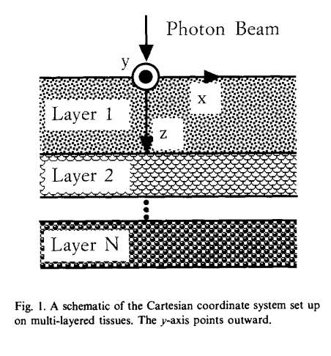
Background: Monte Carlo modeling of light transport in multi-layered tissues(MCML)
This model deals with the transportation of an infinitely narrow photon beam, perpendicularly incident on a multi-layered tissue.
Photons’ interaction with the tissue can be mainly described as absorption, scattering and deflection.
The light intensity distribution is detected at the surface of the tissue.
Lihong Wang, et al., Computer Methods and Programs in Biomedicine, 47: 131-146, 1995

Slide 4
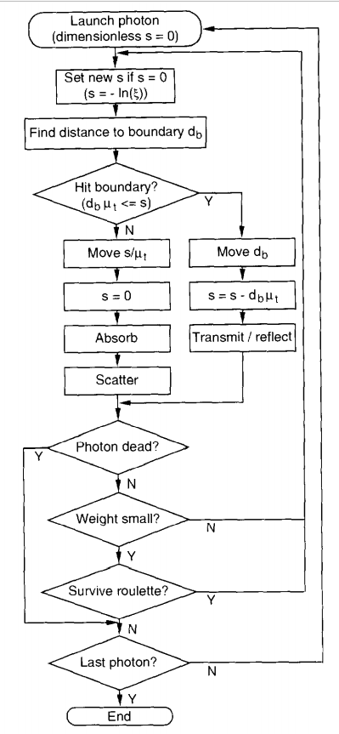
Simulating procedure
Photon launching
Step size
Photon moving
Photon absorption
Photon scattering
Photon hitting a boundary
Photon termination

Slide 5
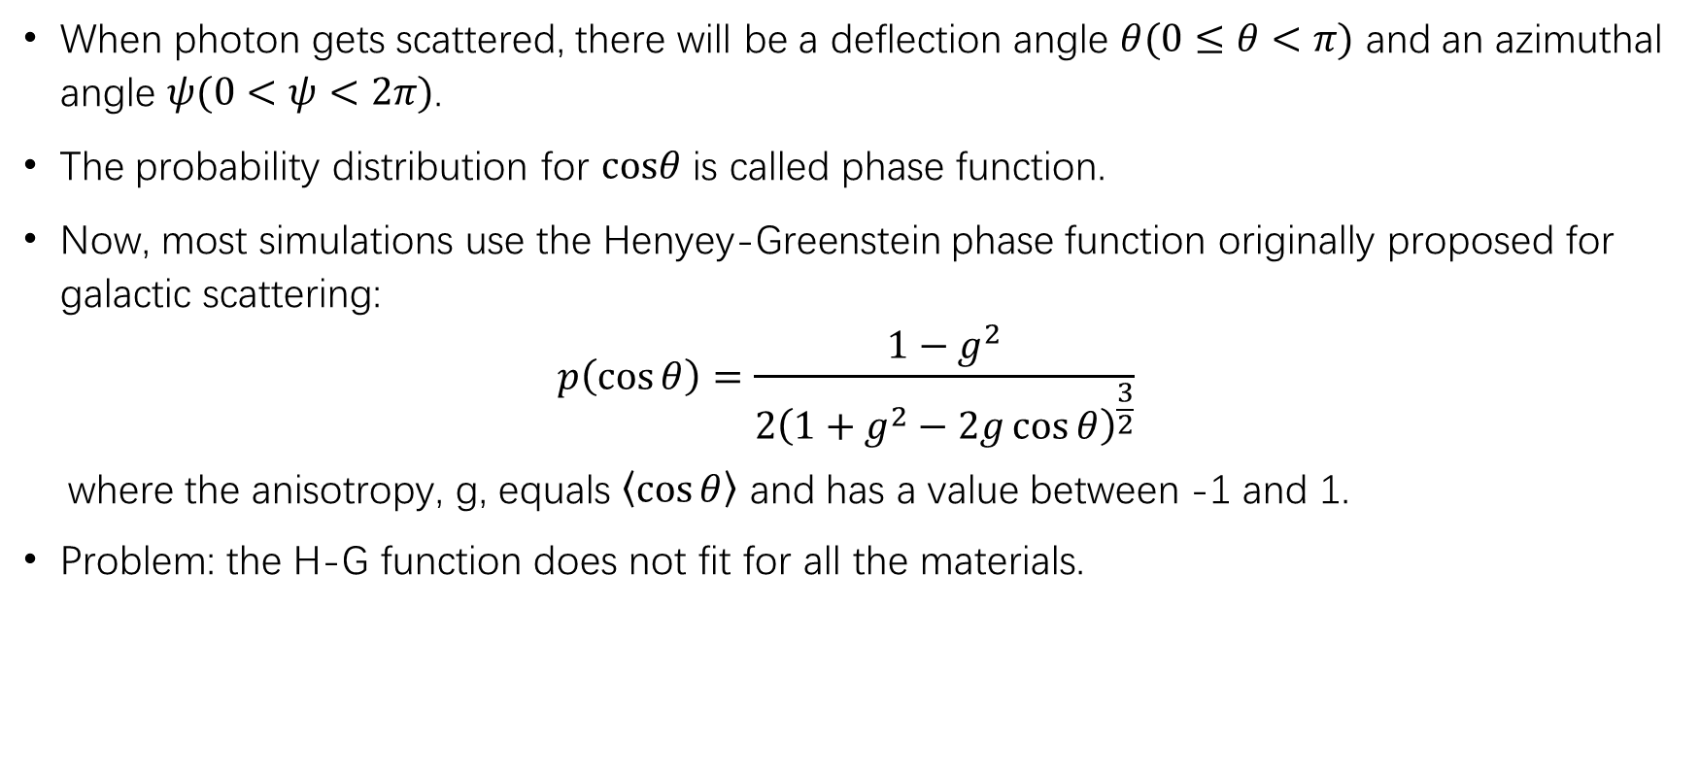
Photon scattering
When photon gets scattered, there will be a deflection angle $θ(0≤θ<π)$ and an azimuthal angle $ψ(0<ψ<2π)$.
The probability distribution for $cosθ$ is called phase function.
Now, most simulations use the Henyey-Greenstein phase function originally proposed for galactic scattering:
$$p\left(\cos{θ}\right)=\frac{1−g^{2}}{2{\left(1+g^{2}−2g\cos{θ}\right)}^{\frac{3}{2}}}$$
where the anisotropy, g, equals $\left\langle \cos{θ}\right\rangle$ and has a value between -1 and 1.
Problem: the H-G function does not fit for all the materials.

Slide 6
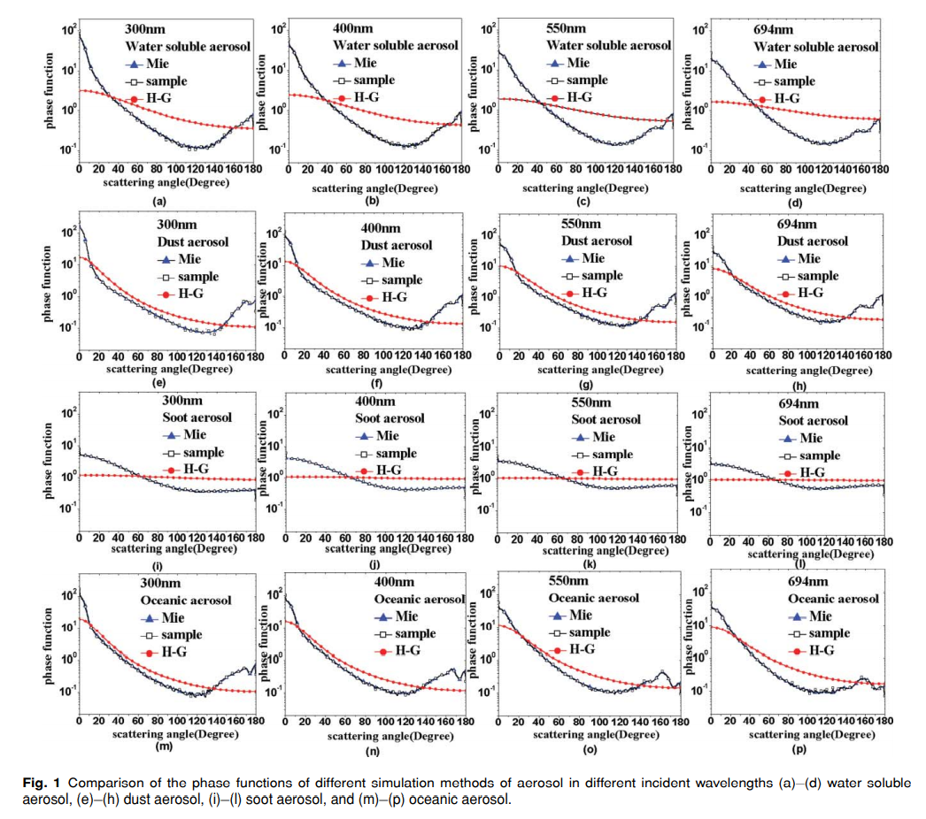
Study on phase function in Monte Carlo transmission characteristics of poly-disperse aerosol
Lu Bai, et al., Optical Engineering 50(1), 016002, 2011

Slide 7
Proposal
Although H-G function is widely used in MCML, it doesn’t fit for all kinds of materials.
Can we use the machine learning method to find a better model to fit the real phase functions of tissues?

Slide 8
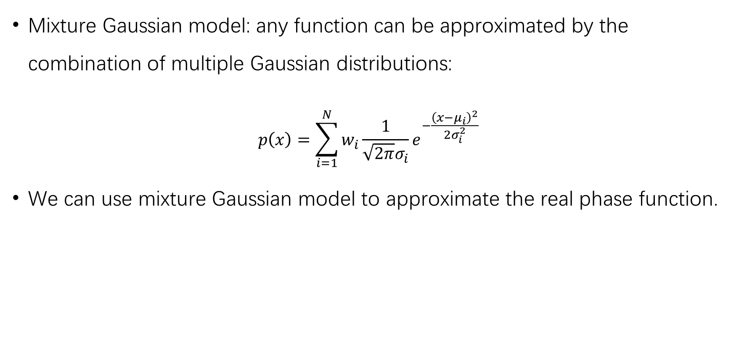
Mixture Gaussian model: any function can be approximated by the combination of multiple Gaussian distributions:
$$p\left(x\right)=\sum_{i=1}^{N}{w_{i}\frac{1}{\sqrt{2π}σ_{i}}e^{−\frac{{\left(x−μ_{i}\right)}^{2}}{2σ_{i}^{2}}}}$$
We can use mixture Gaussian model to approximate the real phase function.

Slide 9
Scheme design
Use MOSE toolkit to generate light intensity distribution images. While simulating, we can still use H-G function.
Use a neural network to learn the phase function. The input is the reflectance images obtained in MOSE, and the output is the weights and variances of those Gaussian distributions.
Perturb the phase function in simulation to test the generalization ability of the network.
Shenghan Ren, et al., PLoS ONE, 8(4):e61304, 2013.

Slide 10
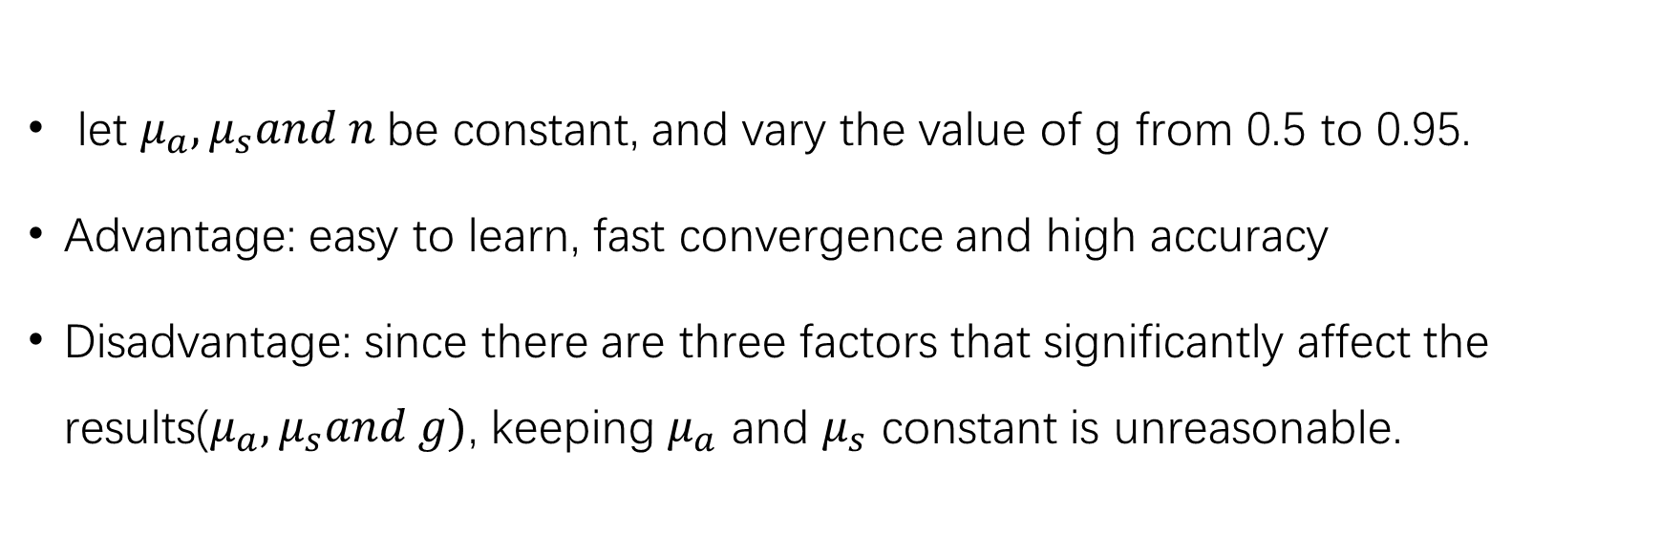
Dataset V1
let $μ_{a},μ_{s}and n$be constant, and vary the value of g from 0.5 to 0.95.
Advantage: easy to learn, fast convergence and high accuracy
Disadvantage: since there are three factors that significantly affect the results($μ_{a},μ_{s}and g)$, keeping $μ_{a}$ and $μ_{s}$ constant is unreasonable.

Slide 11
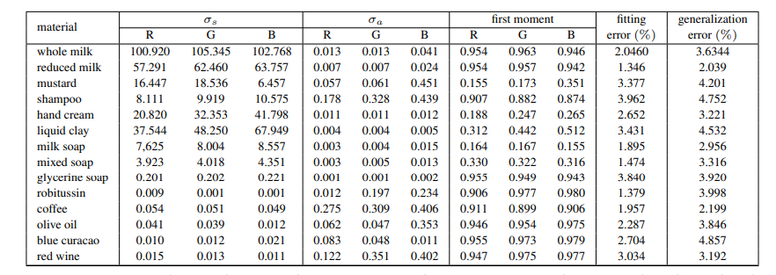
Dataset V2: based on real material parameters
Ioannis Gkioulekas, Inverse Volume Rendering with Material Dictionaries, ACM Transactions on Graphics, Volume 32, Issue 6 (2013)

Slide 12
Dataset V3: parameters vary in large ranges
𝜇𝑎: [0.001, 0.05, 0.1, 0.5, 1, 2, 5, 10]
𝜇𝑠 : [0.01, 0.05, 0.1, 0.5, 1, 5, 10, 50, 100]
g :[-1:0.1:1]
1512 groups of parameters in total
For each group: 80 images for training, 20 for testing

Slide 13
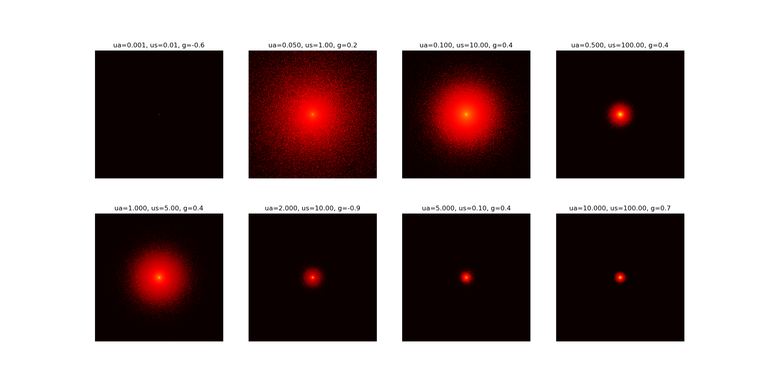
Example images
For visualization, the dynamic range of the images are compressed to the 0.01 power of the original.

Slide 14


Network Structure: 6 convolution layers, 1 fc layer
conv1
$$μ_{a}$$
conv2
conv3
conv4
conv5
conv6
…
$$μ_{s}$$
g
3*3*32
3*3*32
3*3*64
3*3*64
3*3*128
3*3*128

Slide 15
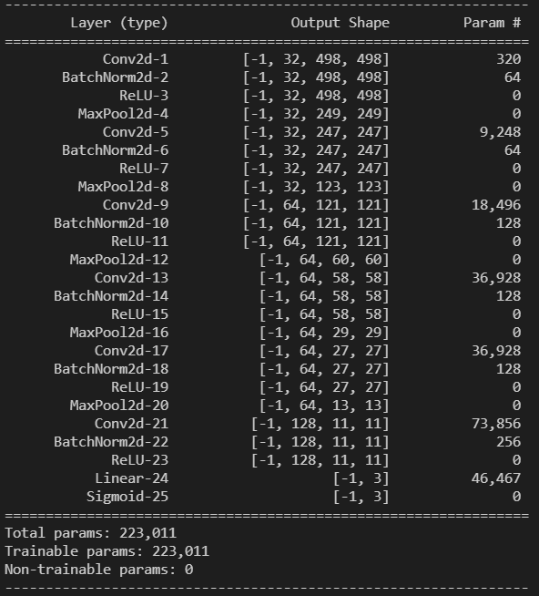
Implement details
GPU: Titan Xp
Dependency: Pytorch 1.8.1
Loss function: MSE
Optimizer: Adam
Initial learning rate: 5e-4, decreasing it by a factor of 0.1 every 10 epochs
Weight decay: 5e-3
Batch size: 60
The ground truth values are normalized to [0.01,1.01].

Slide 16
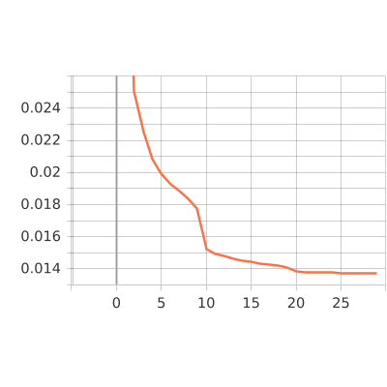
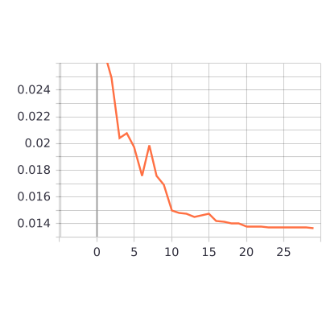
Results (30 epochs)
Training loss
Testing loss

Slide 17
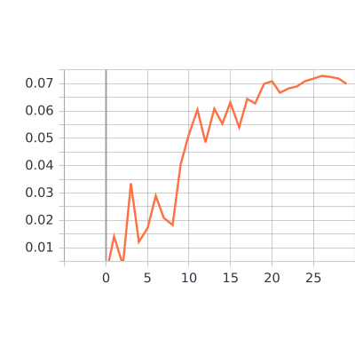
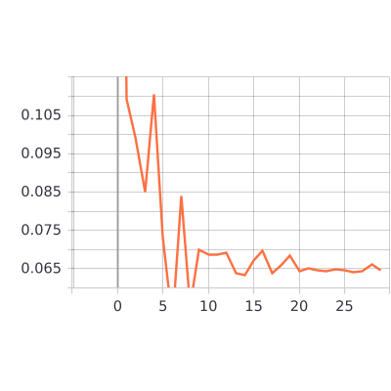
Results (30 epochs)
Rate of samples relative error less than 10%
Rate of samples relative error larger than 50%
Relative error: the relative error of $μ_{a},μ_{s}and g$ are less than 10%.

Slide 18
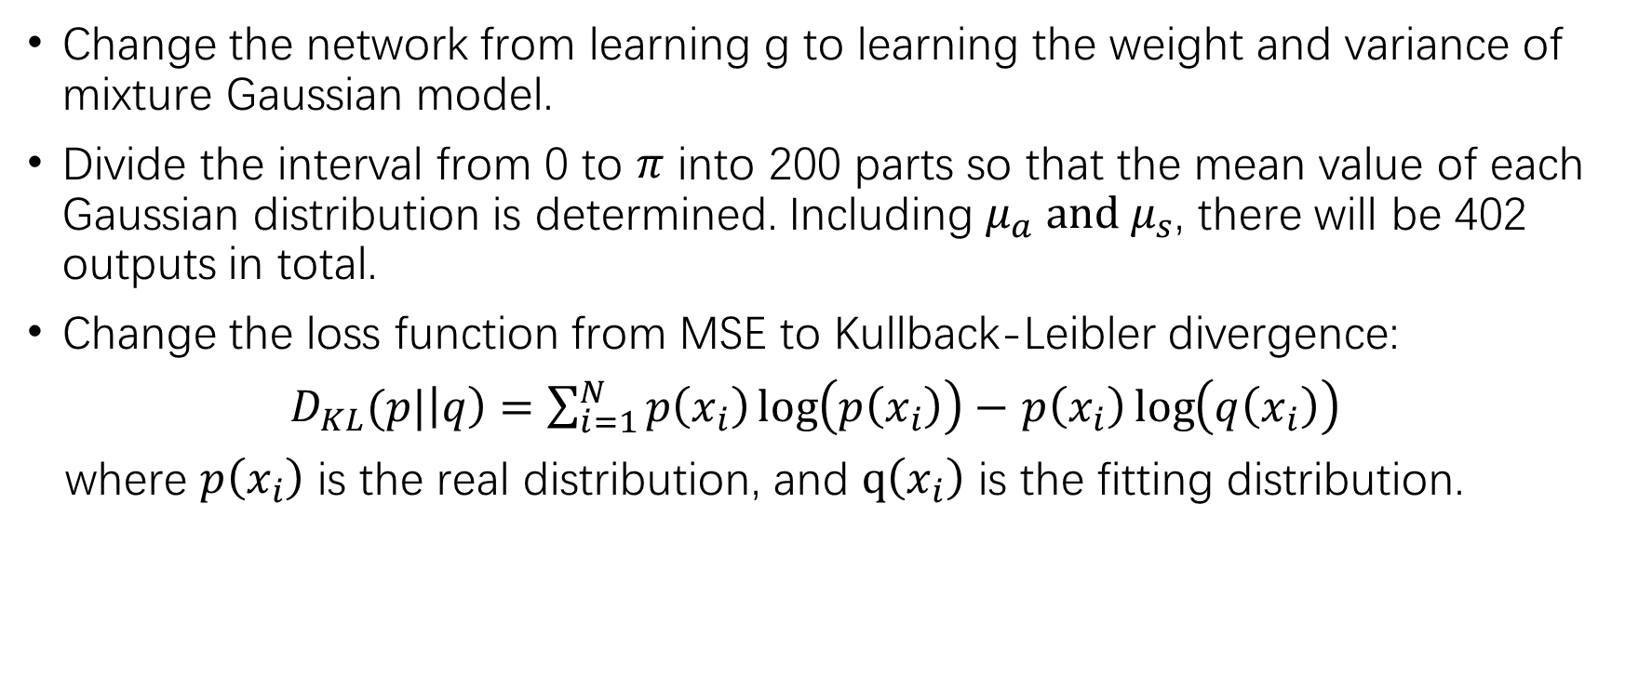
Further plan
Change the network from learning g to learning the weight and variance of mixture Gaussian model.
Divide the interval from 0 to $π$ into 200 parts so that the mean value of each Gaussian distribution is determined. Including $μ_{a} and μ_{s}$, there will be 402 outputs in total.
Change the loss function from MSE to Kullback-Leibler divergence:
$D_{KL}(p|\left|q\right)=\sum_{i=1}^{N}{p\left(x_{i}\right)\log\left(p\left(x_{i}\right)\right)−}$ $p\left(x_{i}\right)\log\left(q\left(x_{i}\right)\right)$
where $p\left(x_{i}\right)$ is the real distribution, and $q\left(x_{i}\right)$ is the fitting distribution.
Ioannis Gkioulekas, Inverse Volume Rendering with Material Dictionaries, ACM Transactions on Graphics, Volume 32, Issue 6 (2013)

Slide 19
Some questions
Images with no photon or only one photon emitting
2d or 1d convolution?

Slide 20
Thanks for listening!

